Slide 1


COVID-19: Finding Answers Within Raw Data to Avoid Media Bias
Jolene M. Branch DSC680: Applied Data Science Bellevue University July 5, 2021

Slide 2

Table of Contents
Purpose and Questions to Answer
Data Sources
Methods
Answers
Conclusions
Resources

Slide 3
Purpose
The purpose of this project is to retrieve and wrangle raw COVID-19 data in order to come to independent conclusions about what the COVID-19 virus is doing. A source of unbiased reporting of COVID-19 information is not known. However, unbiased data is available.

Slide 4
Questions to Answer
“Does COVID-19 ‘survive the winter’ and have higher prevalence rates in countries with higher latitudes?”
“Does it matter if you consider cumulative incidence rather than cumulative prevalence?”
“Does a person count twice toward cumulative incidence rates if he had COVID-19 more than once?“
“Back to the ‘distance-from-the-equator thing, what proof do you have besides ‘bubble size’?”
“What was the big deal about the first million cases? Or first 100,000 deaths?
What is a milestone?”
“Do countries that do better preventing chronic illness have fewer COVID-19 deaths?”
“Do countries with higher population densities have higher COVID-19 cumulative incidence?”
“Is there a correlation between case counts of SARS/MERS and COVID-19 prevalence rates in countries?”
“Did anyone really think that New York City could produce the number of specially trained RNs to care for the patients who would be using the 40,000 additional ventilators that the governor insisted they require?”

Slide 5
Data Sources
‘Routine’ sources of data used in U.S. healthcare system only include U.S. data
Medical community recognizes Johns Hopkins for population data
Many circular references
Notes:
Three datasets from the Johns Hopkins Whiting School of Engineering Github repository (https://github.com/CSSEGISandData) were used. The datasets were in the form of .rds files. One contained COVID case counts and new cases by country. Another contained MERS and SARS data for the same countries, along with environmental and demographic information. A third contained latitude, longitude, and populations. All were imported into R using readRDS().
For healthcare-only data, a data source such as cms.gov would be adequate, as reporting definitions are clear. The CDC has datasets that allow for interactive visualizations, too. These datasets do not include comprehensive international data, however, so are not helpful for this project except as visualization references.

Slide 6
Methods
R used to import, reshape, and join datasets
Variable selection
Data cleaning and dataset trimming
Notes:
After importing the datasets into R, they were written back out as .csv files for simpler importation into SQLite. (Microsoft SQL Server Management Studio was not readily available for use). After trial and error of joining datasets within SQLite and the realization that at least one dataset needed to be changed from long to wide format, all three were brought back into R for reshaping and joining (using merge()). Initial dataset exploration was done at that time using summary().
Variables were selected based on ease of retrieval, availability of data definitions, and clinical understanding of chronic illness and the impact of the external factors, such as national healthcare delivery models, population density, as well as predisposing conditions (such as obesity) on chronic conditions. In the event that enough data would be available for predictive analytic modeling, SARS and MERS prevalence data was included, as “…the lessons we learned in the past from the SARS and the MERS epidemics are the best cultural weapons with which to face this new global threat.” (Petrosillo et al., 2020). Interestingly, China, which is known to be the country of origin of the COVID-19 virus, had the highest count of SARS cases.
Because COVID-19 data has been fastidiously collected on a daily basis by organizations such as Johns Hopkins, many publicly available datasets are of such great size as to make personal handling unfeasible (Kellen & Maragakis, N.D.). This was mitigated by taking a single point in time snapshot of COVID-19 data across the world. The date selected was June 11, 2021. Fortunately, epidemiologic data nearly always contains ‘cumulative’ data and/or prevalence data, so even a single point in time scan of available data reveals much more than what is occurring on just that day.
After merging the three datasets, cleaning and wrangling the data, and spot checking for sanity, the combined dataset was imported into Power BI. Calculated columns of infectious disease prevalence rates of COVID-19, MERS, and SARS were created next. The validity of the MERS and SARS data is questionable due to extremely small case counts, as neither of those diseases made it to the ‘pandemic’ level of spread.

Slide 7
Methods (continued)
Outlier detection and missing value decisions
Power BI visualizations used to augment analysis
Notes:
The normal process of outlier detection was viewed differently within this project than within most data science projects. Traditionally, each variable in a dataset is examined, often via visual representations such as histograms, cumulative distributive function (CDF), or probability mass frequency (PMF) charts. In the case of a brand new rapidly emerging virus, however, outliers are to be expected and attempts to remove them introduce the risk of destroying essential elements of insight within the dataset. The matter of miniscule sample sizes (from countries with population of less than 100,000, for example) and their propensity to skew data was decided to be too likely to introduce noise into the understanding of COVID-19, and those countries were removed from the datasets prior to analysis. Unfortunately, many of the countries with populations of less than 100,000 share other characteristics, such as island status and location in warmer climates (or nearer to the equator).
Additionally, countries that were not able to supply data on such commonly collected and reported variables such as obesity, smoking, and HIV status were eliminated from the datasets due to concerns about credibility of any of the supplied data given the glaring omissions of ‘standard’ public health data. These attempts to decrease noise within the data likely served to remove demographically similar countries from the dataset, which does decrease applicability (or decrease generalizability) across all countries.
Power BI was used for exploratory data analysis. Based on those findings, the data was pulled back into R for additional examination, such as correlation coefficient review.

Slide 8
Answers!

Slide 9
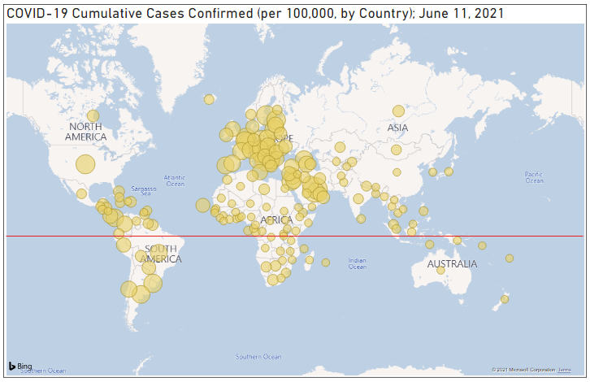
“Does COVID-19 ‘survive the winter’ and have higher prevalence rates in countries with higher latitudes?”
It looks like the circles tend to be larger the further they are from the equator, right?
Note: Larger circle size indicates higher cumulative incidence

Slide 10
“Does it matter if you consider cumulative incidence rather than cumulative prevalence?”
Not so much for a brand-new disease, especially if you are considering cumulative case counts from the beginning until now.

Slide 11
“So then does a person count twice toward cumulative incidence rates if he had COVID-19 more than once?”
Maybe.
Only if tested more than once.
Scare reports of this occurring.
Notes:
point prevalence vs. period prevalence, https://www.cdc.gov/csels/dsepd/ss1978/lesson3/section2.html
The dataset used did not use point prevalence or period prevalence. It used cumulative cases, and the description table did not specify if this referred to unique persons or not. Therefore, it is likely that the cumulative cases reported in this dataset will include individuals who tested positive, then negative at least twice at a minimum number of days between testing (or whatever standard each country uses), then positive again. Reports of this occurring have been scarce, and likely do not affect conclusions gained from this project.

Slide 12
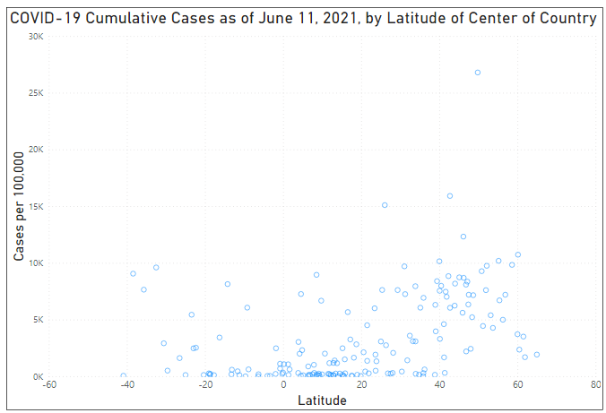
“Back to the ‘distance-from-the-equator thing, what proof do you have besides ‘bubble size’?”
What letter do these data points take the form of? What does that mean?
Notes:
Since distance from the equator can be calculated as the absolute value of the latitude, a latitude of 40 is the same distance from the equator as a latitude of -40. From this chart a sort of ‘V’ shape among rates of COVID-19 prevalence as compared to latitude of the center of the country. This suggests a correlation between latitude and COVID-19 prevalence.

Slide 13
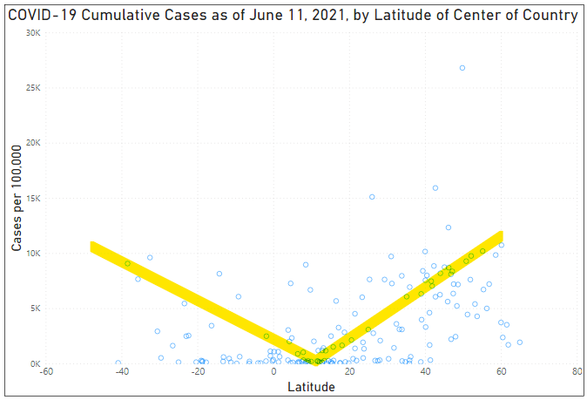
Notes:
Since distance from the equator can be calculated as the absolute value of the latitude, a latitude of 40 is the same distance from the equator as a latitude of -40. From this chart a sort of ‘V’ shape among rates of COVID-19 prevalence as compared to latitude of the center of the country. This suggests a correlation between latitude and COVID-19 prevalence.

Slide 14
“What was the big deal about the ‘first million cases’ or ‘first 100,000 deaths?’ What is a ‘milestone?’
‘Round numbers’
Sound scary and get peoples’ attention
No statistical significance
Potential for misunderstanding is great
Notes:
Use of arbitrary numbers ending with a lot of zeros has great potential to skew peoples’ understanding of the severity of the disease and/or its spread.
When the news announcer says “The U.S. has hit a milestone 1 million cases today,” the viewer has no context for that statement and is likelier than not to interpret that somehow things are worse today than they were yesterday.
The only thing ‘milestone’ about 1 million cases is that there are 1 million more than when we had zero cases.
Better uses of the term milestone might be the date that vaccinations started or the number of days since disease discovery until vaccine approval or the point at which the number of deaths exceeds the number of deaths of some other significant event in history.
Without any context, there really is no milestone.

Slide 15
“Do countries that do better preventing chronic illness have fewer COVID-19 deaths?”
Counts vs rates
Apples to oranges!

Slide 16
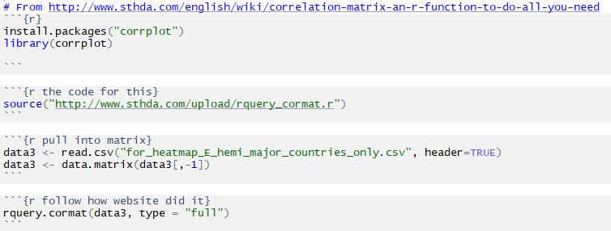
“So we can’t tell if countries that do better preventing chronic illness have fewer COVID-19 deaths?”
Notes:
With just a couple lines of code, using the right library, the dataset that was already cleaned and ‘wrangled’ in R can produce some amazing insights.

Slide 17
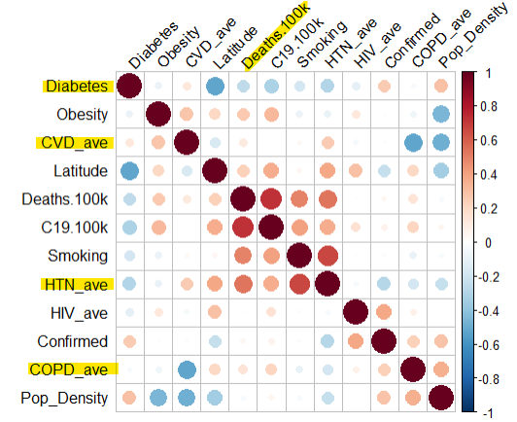
“So we can’t tell if countries that do better preventing chronic illness have fewer COVID-19 deaths?”
Yes, we can! COVID-19 death rates are higher in countries that do poorer at prevention of chronic medical conditions. *Diabetes appears to be reversed.
Perfect positive correlation
Perfect negative correlation
Notes:
The key to comparing different variables and attempting any kind of regression or correlation is to convert case counts to case rates, based on population.
In the correlation matrix, COVID deaths have a positive correlation with every chronic condition listed EXCEPT DIABETES. The only variable on the correlation matrix that does not have a positive correlation with death, interestingly, is diabetes. Not even in the media has it been suggested that having diabetes is some sort of protective factor against COVID-19! Since diabetes and obesity do not show as having a positive correlation (which is simply common knowledge), this is a clue that something is amiss with the diabetes variable within this dataset.

Slide 18
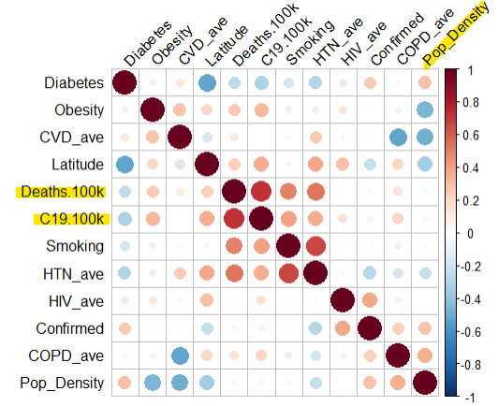
“Do countries with higher population densities have higher COVID-19 cumulative incidence?”
There does not appear to be a correlation between population density and COVID-19 cases per 100,000 or COVID-19 deaths per 100,000.
Notes:
This seems surprising.

Slide 19
“Is there a correlation between case counts of SARS/MERS and COVID-19 prevalence rates in countries?”
Sure. If you want there to be.
Or not, if you don’t want it!
super small case count = easy to ‘spin’ the data
Notes:
Upon further review of SARS and MERS data as collected by the Johns Hopkins Whiting School of Engineering, it was discovered that so few countries had formally reported actual cases of SARS and MERS, that valid comparison with COVID-19 case prevalence would not be possible. There simply is not enough case count data.

Slide 20
“Did anyone really think that New York City could produce the number of specially trained RNs to care for the patients who would be using the 40,000 additional ventilators that the governor insisted they require?”
Certainly not anyone in healthcare.
At a superhero-like 1:2 staffing ratio, with every ICU RN working 12-hour shifts, 7 days a week, with no absences due to illness or quarantine, you would need 40,000 additional ICU RNs.
“A source of unbiased reporting of COVID-19 information (and a lot of other things) is not known. However, unbiased data is available.”
Notes:
Care of ventilator-dependent intensive care unit (ICU) patients is generally done at a 1:1 or 1:2 staffing ratio.
Add in the immense amount of time to ‘suit up’ for each trip into a patient room, and a 1:2 ratio would quickly wear down even the most experienced, energetic RN.
Assuming that everything else is perfect, and that these superheroes could work 12 hour shifts, 7 days per week indefinitely, you would need an additional 40,000 experienced ICU RNs to staff the patients on the requested 40,000 additional ventilators. And that doesn’t even take the doctors into account!
Yes, of course you can shift staff around, especially as in-person clinic visits and elective surgeries are cancelled, but none of those actions will produce 40,000 ICU RNs.

Slide 21
Conclusion
“A source of unbiased reporting of COVID-19 information (and a lot of other things) is not known. However, unbiased data is available.”

Slide 22
References
Asrani, P., Hasan, G. M., Sohal, S. S., & Hassan, M. D. I. (2020, November 24). Molecular Basis of Pathogenesis of Coronaviruses: A Comparative Genomics Approach to Planetary Health to Prevent Zoonotic Outbreaks in the 21st Century. Omics : a journal of integrative biology. https://pubmed.ncbi.nlm.nih.gov/32940573/
Bernstein, B. (2021, April 17). COVID-19 Death Toll Surpasses 3 Million Worldwide. National Review. https://www.nationalreview.com/news/covid-19-death-toll-surpasses-3-million-worldwide/
D'Agostino, A., Demartini, B., Cavallotti, S., & Gambini, O. (2020, May). Mental health services in Italy during the COVID-19 outbreak. The Lancet: Psychiatry. https://doi.org/10.1016/S2215-0366(20)30133-4
Dong, E., Du, H., & Gardner, L. (2020, February 19). An interactive web-based dashboard to track COVID-19 in real time. Redirecting. https://doi.org/10.1016/S1473-3099(20)30120-1
Elrashdy, F., Redwan, E. M., & Uversky, V. N. (2020, September 11). Why COVID-19 Transmission Is More Efficient and Aggressive Than Viral Transmission in Previous Coronavirus Epidemics? Biomolecules. https://pubmed.ncbi.nlm.nih.gov/32933047/
El-Sayed, A., Abdel-Daim, M. M., & Kamel, M. (2021, May 5). Causes of respiratory failure in COVID-19 patients. Environmental science and pollution research international. https://pubmed.ncbi.nlm.nih.gov/33954917/

Slide 23
References (continued)
Kellen, G. D., & Maragakis, L. L. (n.d.). COVID-19 Vaccine: What You Need to Know. Johns Hopkins Medicine. https://www.hopkinsmedicine.org/health/conditions-and-diseases/coronavirus/covid-19-vaccine-what-you-need-to-know
Liu, Z., Xiao, X., Wei, X., Li, J., Tan, H., Zhu, J., Zhang, Q., Wu, J., & Liu, L. (2020, March 11). Composition and divergence of coronavirus spike proteins and host ACE2 receptors predict potential intermediate hosts of SARS-CoV-2. Journal of medical virology. https://pubmed.ncbi.nlm.nih.gov/32100877/
Petrosillo, N., Viceconte, G., Ergonul, O., Ippolito, G., & Petersen, E. (2020, March 28). COVID-19, SARS and MERS: are they closely related? Clinical microbiology and infection : the official publication of the European Society of Clinical Microbiology and Infectious Diseases. https://pubmed.ncbi.nlm.nih.gov/32234451/
Singh, R., Kang, A., Luo, X., Jeyanathan, M., Gillgrass, A., Afkhami, S., & Xing, Z. (2021, March). COVID-19: Current knowledge in clinical features, immunological responses, and vaccine development. FASEB journal : official publication of the Federation of American Societies for Experimental Biology. https://pubmed.ncbi.nlm.nih.gov/33577115/
Yang, Y., Rao, X., & Shang, W. (2020, June). Facing the COVID-19 outbreak: What should we know and what could we do? Journal of medical virology. https://pubmed.ncbi.nlm.nih.gov/32091134/

